Slide 1
Rocket League AI
Vladimir Leung
Siyuan Peng

Slide 2
Why Rocket League?
Rocket League is highly 3 dimensional.
Cars stick to the walls and slightly to the ceiling
Cars can jump and boost to fly into the ball
Most games barely use this 3rd dimension
Rocket League has complicated, interesting physics
Goal: General Motion Based Learning
“Mechanics” (exploiting the physics engine)
RL agents are VERY good at exploring/exploiting their environment
Rocket League is a short-term, tactical game
Games can be played in teams (typically largest format is 3v3)
The ball can be controlled or passed to other players
We have access to backend values via BakkesMod!!!
Notes:
Unlike Dota 2, Rocket League is very 3 dimensional.
*talk about jump/boost/aerial*
At the top, a car uses their jump to boost and propel towards the ball and dribble it towards the net

Slide 3
Why Rocket League?
Rocket League is highly 3 dimensional.
Cars stick to the walls and slightly to the ceiling
Cars can jump and boost to fly into the ball
Most games barely use this 3rd dimension
Rocket League has complicated, interesting physics
Goal: General Motion Based Learning
“Mechanics” (exploiting the physics engine)
RL agents are VERY good at exploring/exploiting their environment
Rocket League is a short-term, tactical game
Games can be played in teams (typically largest format is 3v3)
The ball can be controlled or passed to other players
We have access to backend values via BakkesMod!!!
Notes:
Unlike Dota 2, Rocket League is very 3 dimensional.
*talk about jump/boost/aerial*
At the top, a car uses their jump to boost and propel towards the ball and dribble it towards the net

Slide 4
Why Rocket League?
Rocket League is highly 3 dimensional.
Cars stick to the walls and slightly to the ceiling
Cars can jump and boost to fly into the ball
Most games barely use this 3rd dimension
Rocket League has complicated, interesting physics
Goal: General Motion Based Learning
“Mechanics” (exploiting the physics engine)
RL agents are VERY good at exploring/exploiting their environment
Rocket League is a short-term, tactical game
Games can be played in teams (typically largest format is 3v3)
The ball can be controlled or passed to other players
We have access to backend values via BakkesMod!!!
Notes:
Unlike Dota 2, Rocket League is very 3 dimensional.
*talk about jump/boost/aerial*
At the top, a car uses their jump to boost and propel towards the ball and dribble it towards the net

Slide 5
Why Rocket League?
Rocket League is highly 3 dimensional.
Cars stick to the walls and slightly to the ceiling
Cars can jump and boost to fly into the ball
Most games barely use this 3rd dimension
Rocket League has complicated, interesting physics
Goal: General Motion Based Learning
“Mechanics” (exploiting the physics engine)
RL agents are VERY good at exploring/exploiting their environment
Rocket League is a short-term, tactical game
Games can be played in teams (typically largest format is 3v3)
The ball can be controlled or passed to other players
We have access to backend values via BakkesMod!!!
Notes:
Unlike Dota 2, Rocket League is very 3 dimensional.
*talk about jump/boost/aerial*
At the top, a car uses their jump to boost and propel towards the ball and dribble it towards the net

Slide 6
Why Rocket League?
Rocket League presents many similarities and differences to Dota 2
 | Rocket League | Dota 2
Average Game Length | 5-7min avg length games | 70min avg length games
Typical Team size | 3v3 max | 5v5 max
Reaction Time | Low, must be fast | Low, must be fast
Model Size | 10% of Dota 2’s LSTM (7vs70min games) | 80% of model LSTM (14M parameters)
Useful Comparisons | Handful of different car boxes Maps standardized for competition Floor/ceiling/walls + curves in-between Low dimensional, complex 3D game states | 100+ (121) characters 100s (208) of items Large Map (3 “lanes”) Highly dimensional, sparse 2D game states
Notes:
Unlike Dota 2, Rocket League is very 3 dimensional.
*talk about jump/boost/aerial*
At the top, a car uses their jump to boost and propel towards the ball and dribble it towards the net

Slide 7
PPO + MLP + LSTM
Proximal Policy Optimization:
Used by Atari games and Dota 2
Actor-critic style
Use NN to predict future states from current state (Policy/Value networks)
Multi-layer perceptron:
MLP vs CNN limitation (stable_baselines3)
Two hidden layers + tanh activation
LSTM:
Single LSTM used by OpenAI Five, can plan short and long term strategy based on trained memory
Not implemented in stable_baselines3, requires a lot of training

Slide 8
PPO + MLP + LSTM
Proximal Policy Optimization:
Used by Atari games and Dota 2
Actor-critic style
Use NN to predict future states from current state (Policy/Value networks)
Multi-layer perceptron:
MLP vs CNN limitation (stable_baselines3)
Two hidden layers + tanh activation
LSTM:
Single LSTM used by OpenAI Five, can plan short and long term strategy based on trained memory
Not implemented in stable_baselines3, requires a lot of training

Slide 9
PPO + MLP + LSTM
Proximal Policy Optimization:
Used by Atari games and Dota 2
Actor-critic style
Use NN to predict future states from current state (Policy/Value networks)
Multi-layer perceptron:
MLP vs CNN limitation (stable_baselines3)
Two hidden layers + tanh activation
LSTM:
Single LSTM used by OpenAI Five, can plan short and long term strategy based on trained memory
Not implemented in stable_baselines3, requires a lot of training

Slide 10
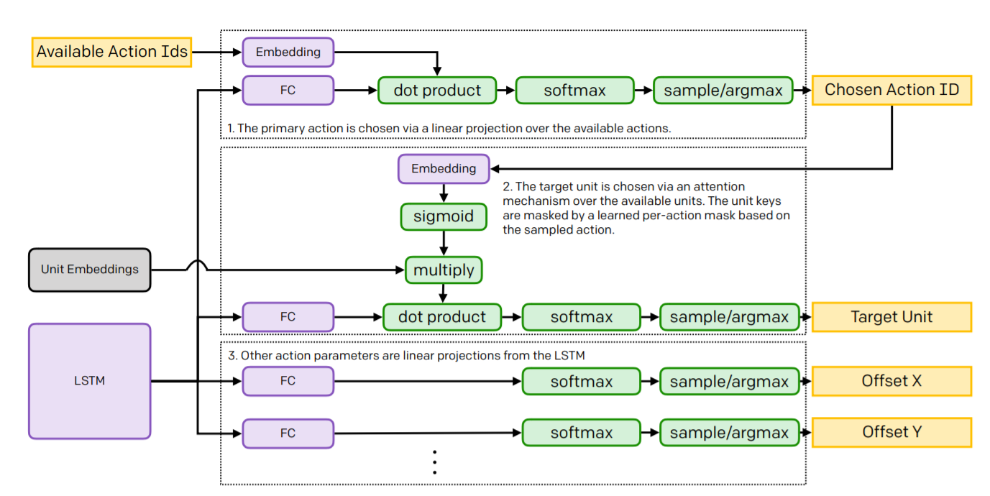
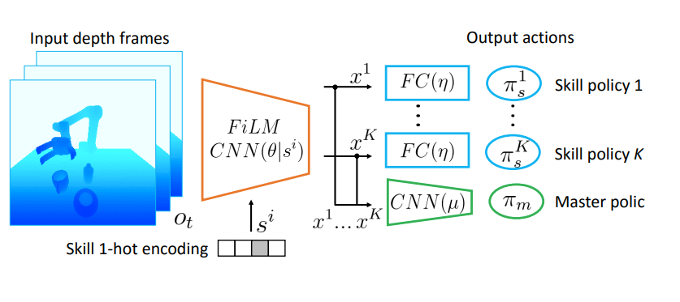
Master-Skill Policy
One LSTM and many FC layers used to predict the agent’s next action.
Dota 2’s long-term strategy is very complex
Rocket League is mechanically complex
We hope to train multiple independent policies and combine them with a master policy, much like in robotics.
Training the master policy to exploit/explore should be simple, just playing against itself
This will be an LSTM+PPO policy, for full length games + shorter plays
Notes:
Unlike Dota 2, Rocket League is very 3 dimensional.
*talk about jump/boost/aerial*
At the top, a car uses their jump to boost and propel towards the ball and dribble it towards the net

Slide 11
Master-Skill Policy
One LSTM and many FC layers used to predict the agent’s next action.
Dota 2’s long-term strategy is very complex
Rocket League is mechanically complex
We hope to train multiple independent policies and combine them with a master policy, much like in robotics.
Training the master policy to exploit/explore should be simple, just playing against itself
This will be an LSTM+PPO policy, for full length games + shorter plays
Notes:
Unlike Dota 2, Rocket League is very 3 dimensional.
*talk about jump/boost/aerial*
At the top, a car uses their jump to boost and propel towards the ball and dribble it towards the net

Slide 12
Master-Skill Policy
One LSTM and many FC layers used to predict the agent’s next action.
Dota 2’s long-term strategy is very complex
Rocket League is mechanically complex
We hope to train multiple independent policies and combine them with a master policy, much like in robotics.
Training the master policy to exploit/explore should be simple, just playing against itself
This will be an LSTM+PPO policy, for full length games + shorter plays
Notes:
Unlike Dota 2, Rocket League is very 3 dimensional.
*talk about jump/boost/aerial*
At the top, a car uses their jump to boost and propel towards the ball and dribble it towards the net

Slide 13
Master-Skill Policy
One LSTM and many FC layers used to predict the agent’s next action.
Dota 2’s long-term strategy is very complex
Rocket League is mechanically complex
We hope to train multiple independent policies and combine them with a master policy, much like in robotics.
Training the master policy to exploit/explore should be simple, just playing against itself
This will be an LSTM+PPO policy, for full length games + shorter plays
Notes:
Unlike Dota 2, Rocket League is very 3 dimensional.
*talk about jump/boost/aerial*
At the top, a car uses their jump to boost and propel towards the ball and dribble it towards the net

Slide 14
Current Training Strategy + Demo
Single Offensive Agent
Goal: train an agent for scoring a goal only

Slide 15
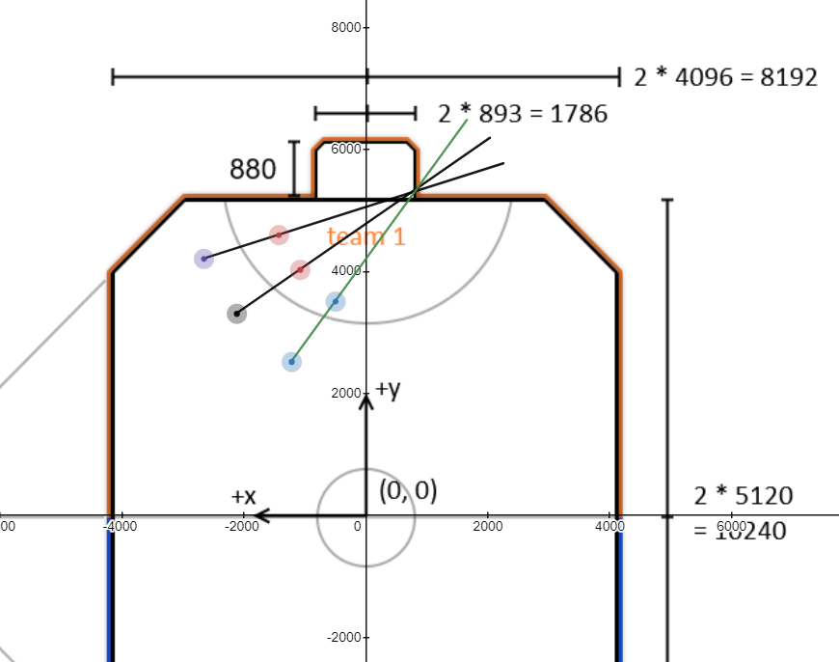
Current Training Strategy + Demo
Single Offensive Agent
Goal: train an agent for scoring a goal only
Create shooting drills that escalate in difficulty + variation for “augmentation”
Drills are quite simple, but much work is needed to truly generalize shooting (random spawns)
Bouncing Ball shot locations/path

Slide 16

Current Training Strategy + Demo
Single Offensive Agent
Goal: train an agent for scoring a goal only
Create shooting drills that escalate in difficulty + variation for “augmentation”
Drills are quite simple, but much work is needed to truly generalize shooting (random spawns)
Combined Reward:
TouchBallReward(50/touch)
GoalReward (100/goal)
MoveTowardsBallReward(Magnitude of
Velocity projection/frame)
TimeReward(-1/sec)
Bouncing Ball shot locations/path
Demo of 4M timestep Model

Slide 17
Upcoming Training Strategy
More Skills
Provide further skills like dribbling, boost management, pinching, etc.
Initialize with mimic learning
Dueling Agents
Goal: 1v1 agents duel to learn how to attack a defending player
Simpler Reward: GoalReward(+/-) + TimeReward (-)
Utilize dueling to combine skills.
Introduce LSTM
An LSTM backing PPO will give much needed temporal memory
Will take substantially longer to train, but will be the most hands off
Dueling bots should be enough for the bot to utilize and combine these skills

Slide 18
Upcoming Training Strategy
More Skills
Provide further skills like dribbling, boost management, pinching, etc.
Initialize with mimic learning
Dueling Agents
Goal: 1v1 agents duel to learn how to attack a defending player
Simpler Reward: GoalReward(+/-) + TimeReward (-)
Utilize dueling to combine skills.
Introduce LSTM
An LSTM backing PPO will give much needed temporal memory
Will take substantially longer to train, but will be the most hands off
Dueling bots should be enough for the bot to utilize and combine these skills

Slide 19
Upcoming Training Strategy
More Skills
Provide further skills like dribbling, boost management, pinching, etc.
Initialize with mimic learning
Dueling Agents
Goal: 1v1 agents duel to learn how to attack a defending player
Simpler Reward: GoalReward(+/-) + TimeReward (-)
Utilize dueling to combine skills.
Introduce LSTM
An LSTM backing PPO will give much needed temporal memory
Will take substantially longer to train, but will be the most hands off
Dueling bots should be enough for the bot to utilize and combine these skills

Slide 20
Challenges
Algorithmic
How to help agent take advantage of 3D space
Adequately combining agents with master policy
Tuning
How to set appropriate weights for each rewards in combined reward
General or hyper-tuned total reward for solo fight scenario
Creating proper exercises for the agent to master a particular skill
Codifying teamwork into exercises

Slide 21
Challenges
Algorithmic
How to help agent take advantage of 3D space
Adequately combining agents with master policy
Tuning
How to set appropriate weights for each rewards in combined reward
General or hyper-tuned total reward for solo fight scenario
Creating proper exercises for the agent to master a particular skill
Codifying teamwork into exercises

Slide 22
Challenges
Logistics
Scaling up systems properly (Google Cloud cannot RDP+run DX11 apps)
Training may take weeks with hardware capabilities (single GPU)
Distributed Learning is “underdeveloped” by RLGym
Developing a stable_baselines2 PPO2+LSTM equivalent (stable_baselines3 does not include any PPO + LSTM, or optimized PPO2 model)
Speed-up is not stable… testing is not consistent

Slide 23
Future Plan
Train an agent to master different “Skills”, combined with a master policy
Optimize exercises and/or learn skills by first observing (aka mimic learning)
Create an efficient distributed learning pipeline
Eventually Train Multi-agent cooperation (i.e. 3V3)
Learn cooperation (passing, positioning, planning)
Codify different strategies to kickstart team-based play, much like the “skills” concept above

